Slide 1



Fine Tuning On Medgemma

Slide 2
Team member:
Jessica Ayman Naeam Yani
Sherry Ayman Shekerum Ibrahim
Abram Ashraf Abd-ElSayed Shehata
Abeer Tawab Hakim Ghibrial
Maureen Mohsen Wagheem Mahny
Enas Ikram Girgis Ibrahim
David Maged Samwel Tawadros
Supevised by:
Dr. Sara Salah Mohamed

Slide 3
What is MiniGPT-Med?
MiniGPT-Med is an AI model designed for medical vision-language tasks.
It works with various types of medical imaging, including X-rays, CT scans, and MRIs.
It can perform multiple tasks, such as:
• Medical report generation
• Visual Question Answering (VQA)
• Disease identification
It combines image and text data to improve diagnostic accuracy.
The goal is to be a general-purpose tool for radiology that enhances diagnostic efficiency.

Slide 4
What is Gemma3?
Gemma3 is a large language model (LLM) developed by Google.
It is designed for text understanding and generation.
Works with text only (no image input).
Contains 34 decoder layers with self-attention and MLP blocks.
MedGemma is built on top of Gemma3, transforming it into a multi-modal model with visual understanding, specialized for medical applications.

Slide 5
What is MedGemma?
MedGemma is a state-of-the-art collection of AI models built to process and understand medical text and images.
Developed by Google DeepMind and launched in May 2025, it is based on the powerful Gemma 3 architecture and optimized specifically for healthcare use.
As part of the Health AI Developer Foundations, MedGemma aims to make advanced medical AI more accessible to researchers and developers worldwide.

Slide 6
Comes in two versions:
MedGemma 4B – multimodal (image + text)
MedGemma 27B – text-only
Common use cases include:
Medical image classification (radiology, pathology, skin, fundus)
Image interpretation & report generation
Clinical reasoning & medical text comprehension (e.g., triage, summarization)

Slide 7
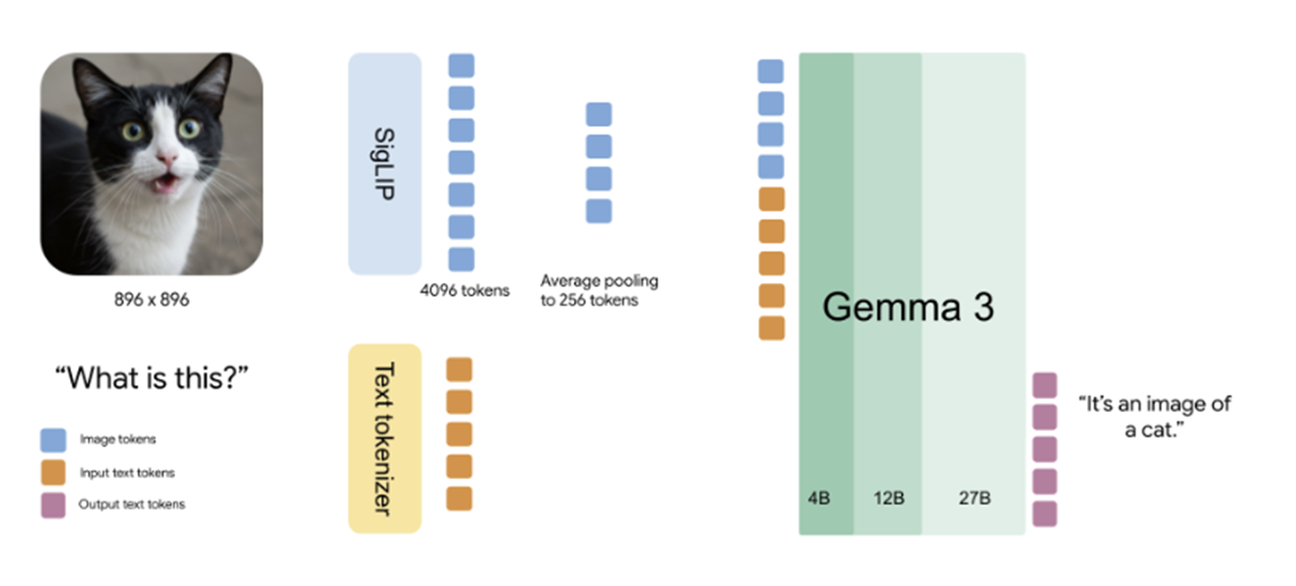
MedGemma Model Architecture
MedGemma combines vision and language. An image is processed by the SigLIP vision encoder and pooled to 256 tokens. Text is tokenized separately. Both are passed to the Gemma3 decoder, which generates a natural language response.

Slide 8
MedGemma Model Architecture
It consists of three main parts:
A Vision Tower for image encoding
A Multi-Modal Projector to bridge vision and text
A Language Model for text generation

Slide 9
Vision Tower :
SigLIP Vision Encoder: processes the input image and extracts meaningful visual features.
Patch Embedding: Splits the image into 14x14 patches using a convolutional layer.
Position Embedding: Adds positional information to each patch.
27 Encoder Layers: Each layer called “SigLipEncoder Layer” includes:
Multi-head Self-Attention
Layer Normalization
MLP with GELU-Tanh activation
Output: Encoded image features passed to the next stage.

Slide 10
Multi-Modal Projector
Gemma3MultiModalProjector: connects the visual and textual information.
RMS Normalization: Normalizes the visual features.
Average Pooling: Reduces the spatial size of the image embedding.
Purpose: Ensures the visual features are compatible with the language model.

Slide 11
Language Model
Gemma3TextModel:The main decoder that generates text based on image features.
Token Embedding: Maps input tokens to high-dimensional vectors.
34 Decoder Layers, each one called “Gamma3Decoder Layer”
Self-Attention: Attends to previous tokens in the sequence.
MLP Block: Projects features with GELU-Tanh activation.
Multiple RMS Normalization Layers: Improve training stability.
Rotary Embedding: Adds positional awareness for attention.

Slide 12
Output Layer
Linear Head (lm_head)
Transforms the final decoder output into vocabulary logits.
Generates a probability distribution over all possible tokens.
Responsible for producing the final text output (word by word).

Slide 13
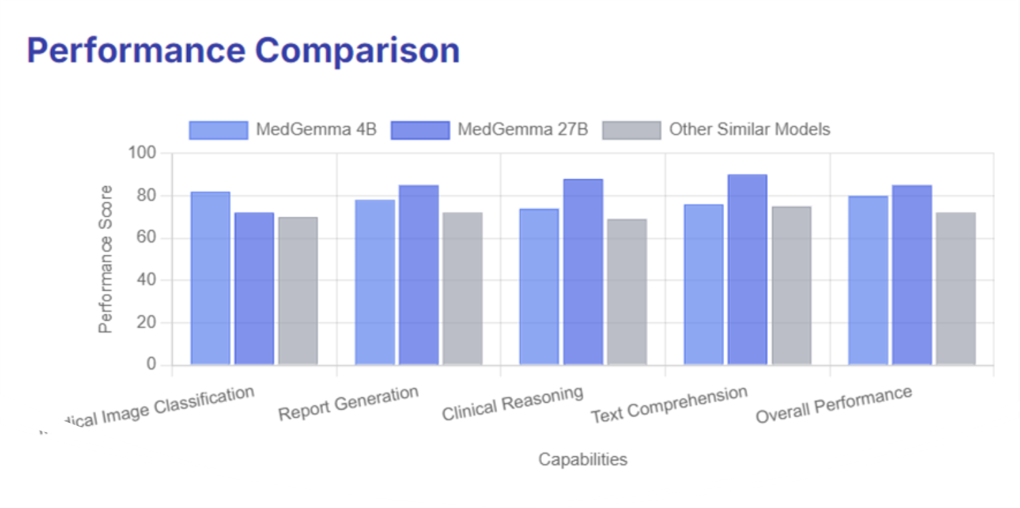
Perfomance Comparison

Slide 14
Let’s dive into the models from a developer’s point of view
Head-to-Head Comparison

Slide 15
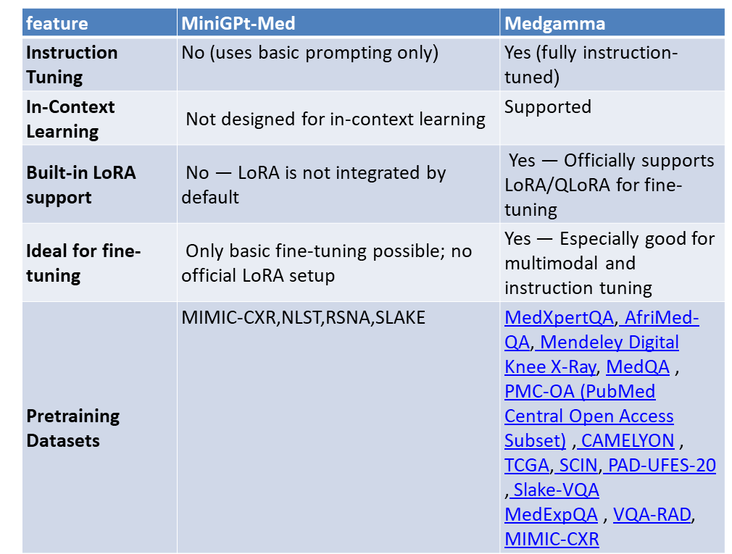

Slide 16
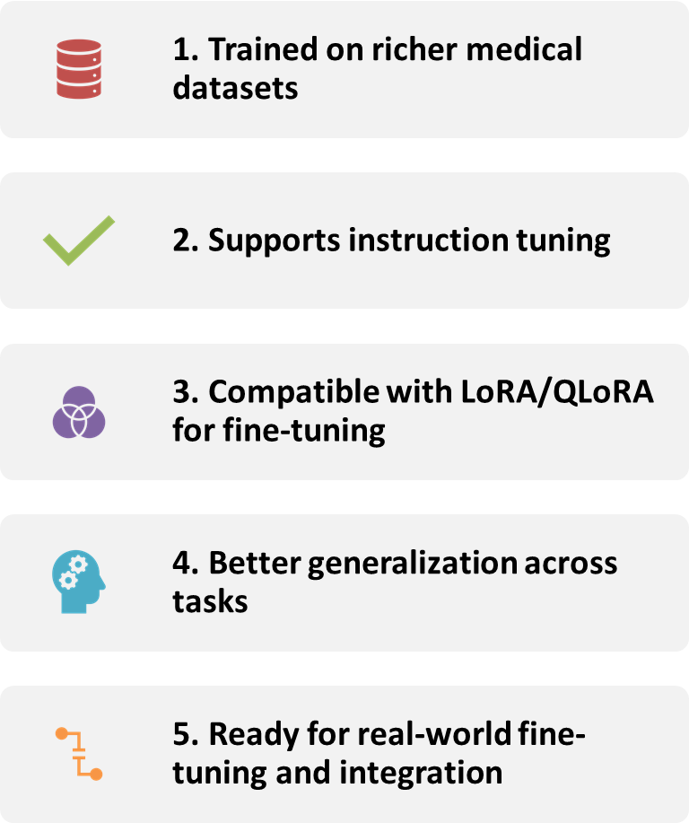
Why MedGemma is Preferred?

Slide 17
What is Fine-Tuning?
Fine-tuning is the process of adapting a pre-trained AI model to perform better on a specific task.
In our case, we fine-tune MedGemma, a powerful medical vision-language model, to classify colon tissue images.

Slide 18
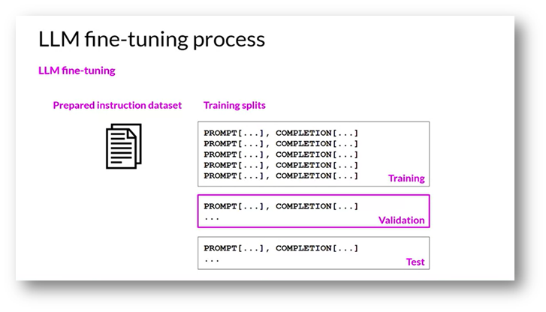
Fine-Tuning Process:
Prepare Data – Convert datasets into instruction-based prompts.
Split Data – Divide into training, validation, and test sets.
Train Model – Adjust model weights using backpropagation.
Evaluate Performance – Measure accuracy and adjust as needed.

Slide 19
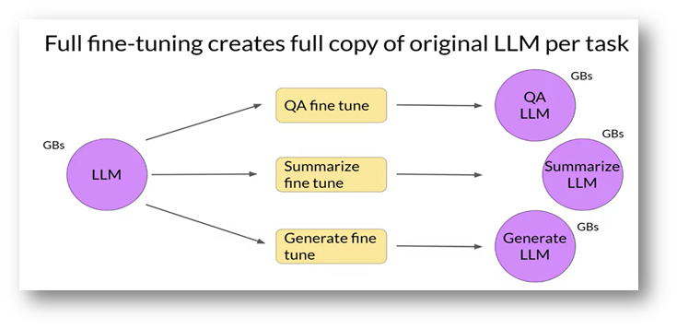
Multi-task Fine-Tuning
Train on multiple tasks simultaneously.
Requires large datasets and high computing power.
full fine tunning creates full copy of original LLM per task.

Slide 20
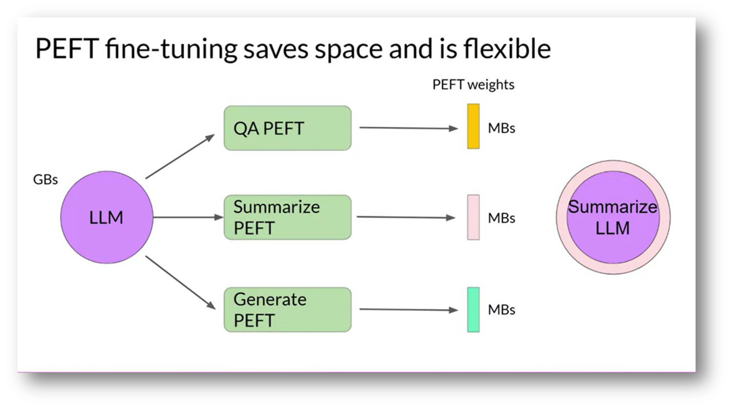
PEFT (Parameter-Efficient Fine-Tuning)
Keeps original model weights unchanged, modifying only task-specific layers.

Slide 21
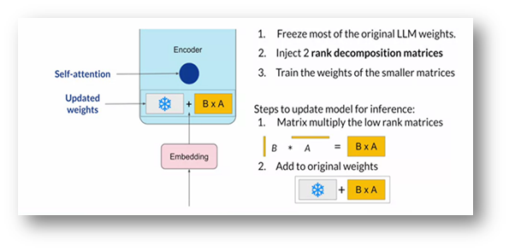
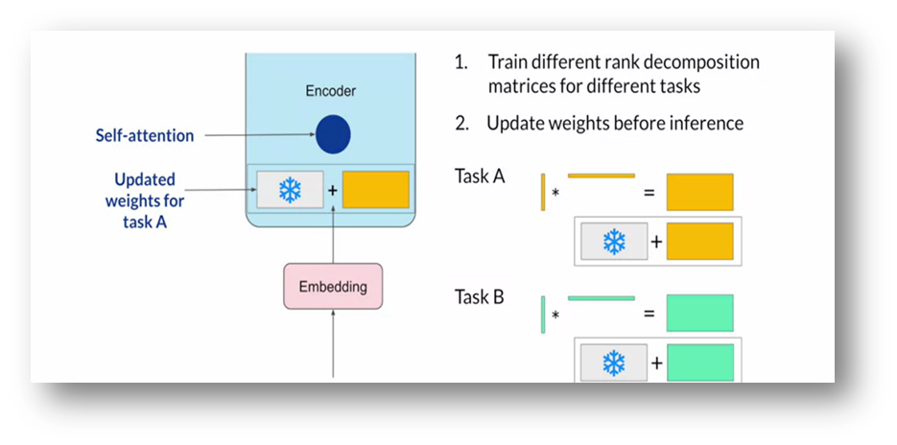
PEFT Approaches:
LoRA (Low-Rank Adaptation) :
Adjusts a small subset of parameters.

Slide 22
Why Use LoRA?
(Traditional vs Efficient Fine-Tuning)
Traditional Fine-Tuning:
Needs high memory (billions of parameters)
Slow and expensive

Slide 23
LoRA & QLoRA:
Trains only small "adapter" layers
Base model stays mostly frozen
Uses 4-bit compression for speed and low memory
This method gives high performance with low cost — ideal for students and researchers!

Slide 24
Let’s start
Fine Tuning

Slide 25
Setup Overview
Login to Hugging Face – to access and download MedGemma securely
Request Access – MedGemma requires approval from Hugging Face
Load the Model – The model is automatically downloaded and used in our notebook
Training is done using Google Colab, leveraging GPU

Slide 26
NCT-CRC-HE-100K Dataset:
Size: 100,000 histological image patches
Image Size: 224 × 224 pixels
Resolution: 0.5 microns per pixel
Stain: Hematoxylin & Eosin (H&E)
Normalization Method: Macenko’s color normalization
Source: Human colorectal cancer (CRC) and healthy tissue
Patch Type: Non-overlapping image patches

Slide 27
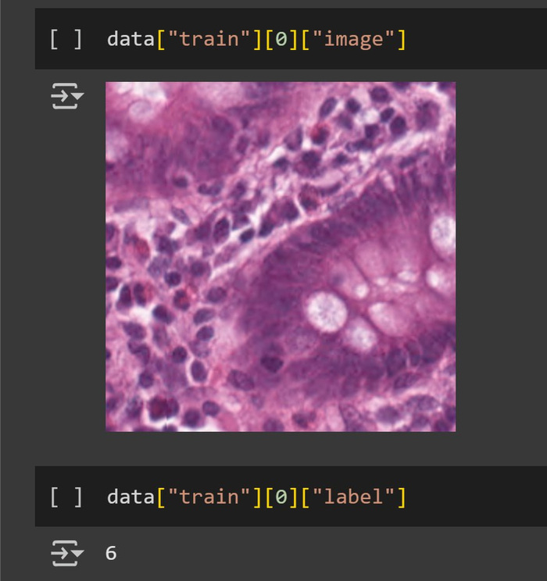
Tissue Classes (9 classes)
ADI: Adipose tissue
BACK: Background
DEB: Debris
LYM: Lymphocytes
MUC: Mucus
MUS: Smooth muscle
NORM: Normal colon mucosa
STR: Cancer-associated stroma
TUM: Colorectal adenocarcinoma epithelium

Slide 28
Our Dataset
We used:
9000 images for training
1000 images for validation
Each image has a label describing the tissue type.

Slide 29
Preparing the Data (Model Format)
We structured each data sample like a conversation between a user and AI:
User: Shows the image and asks what it is
Assistant (AI): Replies with the correct tissue class
Example format used in training:
User: [Image + Prompt]
Assistant: "Colorectal Adenocarcinoma Epithelium"
This format helps MedGemma learn like it's having a conversation.

Slide 30
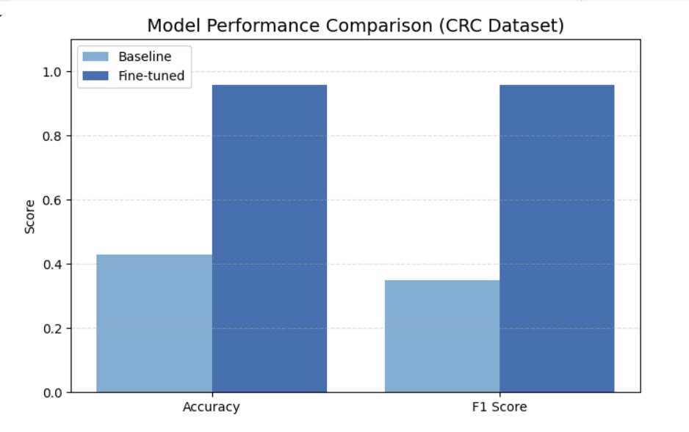
Testing the Model
We compared:
The original base model
The fine-tuned model
See how accuracy improves after teaching the model on our dataset
7000 images for Test

Slide 31
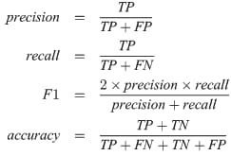
→ How many predicted positives are actually positive.
→ How many actual positives are correctly predicted.

Slide 32
This is the Colab notebook we used to fine-tune MedGemma on the NCT-CRC-HE-100K Dataset for medical image classification:
https://colab.research.google.com/drive/1rOQrAkFkhguH85kuI9pUfV8GwFj3b1D-?usp=sharing
https://colab.research.google.com/github/google-health/medgemma/blob/main/notebooks/fine_tune_with_hugging_face.ipynb?authuser=6#

Slide 33
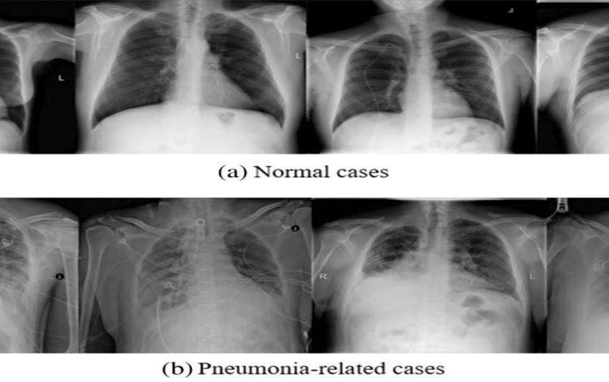
RSNA Dataset:
RSNA (Radiological Society of North America) dataset includes annotated chest X-rays. The dataset comprises 1,218 patients who had at least one or more pneumonia conditions. We use this dataset for image description tasks, training MedGemma to generate meaningful captions for chest X-rays related to pneumonia.

Slide 34
Our Dataset
We used:
630 images for training
80 images for validation
Each image has a label describing the tissue type.

Slide 35
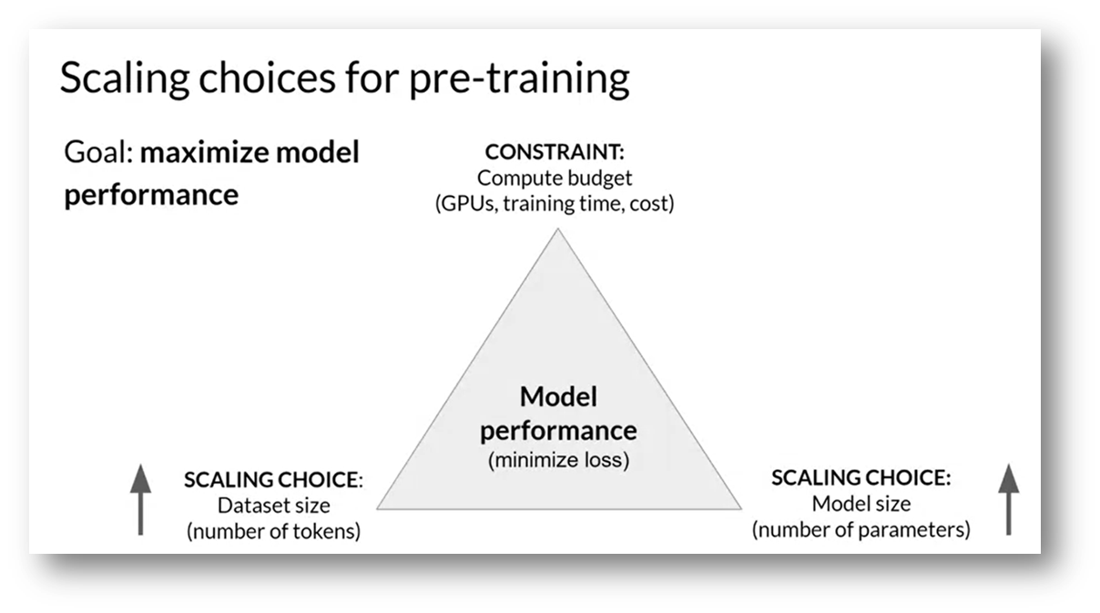
Training Considerations
Balancing Performance & Cost:
We emphasize the need to balance model size, dataset size, and computational resources to ensure efficient training of large language models (LLMs).

Slide 36
Why These Specific Layers Were Fine-Tuned?
We fine-tuned only the final attention layers of the language and vision modules:
Layer 33 in the language model
Layer 26 in the vision encoder
lm_head for output generation
These layers were chosen because:
They capture high-level task-specific features
Updating them improves performance without full retraining
Follows PEFT strategy (efficient and memory-saving)

Slide 37
This is the Colab notebook we used to fine-tune MedGemma on the RSNA dataset for medical image description:
https://colab.research.google.com/drive/1xk2zmtXTqy277YlKaROO9c4rDItaZfoN?usp=sharing
https://colab.research.google.com/drive/1JCBHMRdaPEDoDuV1hq1hK-MveW3yuxz-?usp=sharing

Slide 38
Demo

Slide 39
Our API Deployment
We created a live API demo that allows users to upload a medical image and receive a text-based diagnosis or caption in real-time, using our fine-tuned MedGemma model.
https://drive.google.com/file/d/11RLpDMZ2eM_Pc2Eswu3cLTAYNy-8WXvk/view?usp=drivesdk

Slide 40
Thank You

